Slide 1

Design of an isochronous cyclotron with strong focusing
James Gerity
December 6, 2018
Slides available at http://www.github.com/jgerity/talks

Slide 2
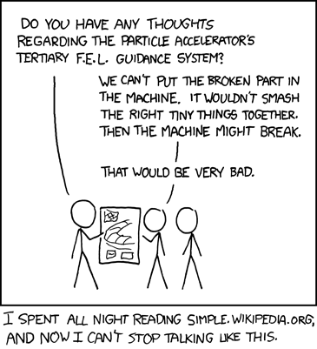
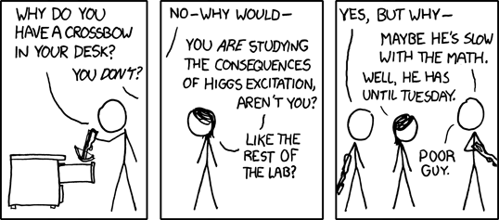
Two styles I hope to avoid
Too little
Too much
Image from https://xkcd.com/564/ under CC BY-NC 2.5
Image from https://xkcd.com/547/ under CC BY-NC 2.5

Slide 3
An open problem: high average current beam
Delivering an intense beam (≥ 10 mA) of protons on target is an attractive goal for several extremely novel purposes:
Proton driver for subcritical fission (ADS)
Production of medical isotopes
Useful for both imaging and treatment of disease
Need high reliability

Slide 4
The cyclotron is a natural design candidate
Cyclotrons are a good blueprint for a high-power machine
High reliability, long history of operational experience with these devices
World record is 2.4 mA at PSI
Original design was ≥ 100 μA, but upgrades and experience over several decades pushed this value up

Slide 5
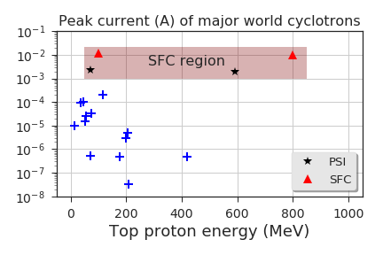
The cyclotron is a natural design candidate
Estimates by W. Joho et al. indicate PSI is close to a theoretical limit of ~3 mA
How can we exceed this limit for continuous operation?
ARL design for an isochronous cyclotron

Slide 6
A crash course in accelerator physics

Slide 7
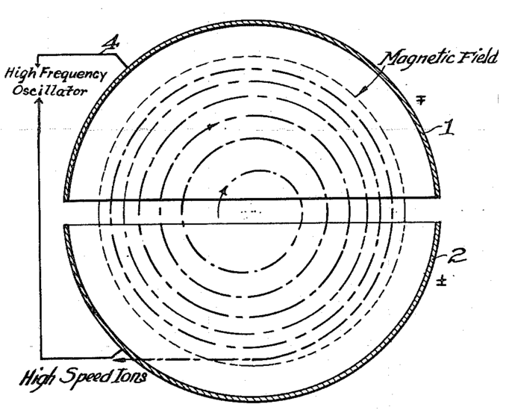
Operational principles of the cyclotron
Electric field → kick charged particle and increase energy
Magnetic field → circular path, reuse acceleration regions many times
Figure from Lawrence’s cyclotron patent (1934). Public domain.

Slide 8
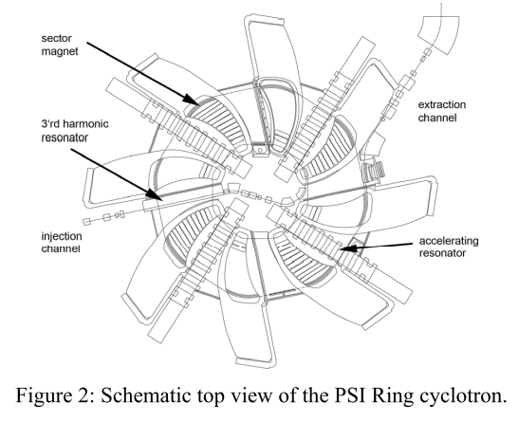
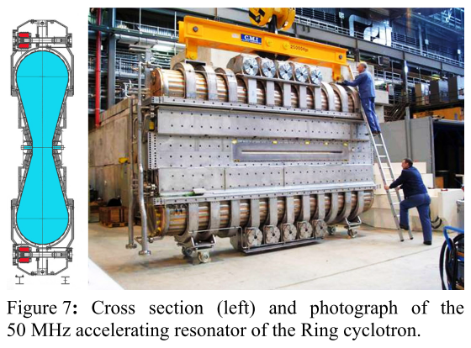
Modern devices are close to the same!
Images of PSI components from Seidel et al. (2010) used here under fair use.

Slide 9
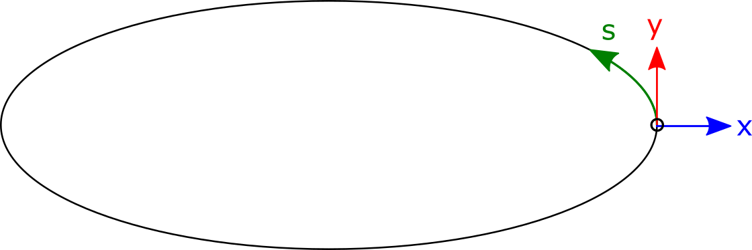
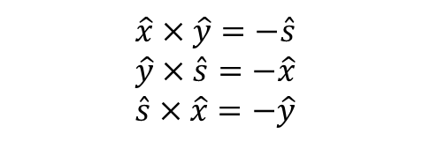
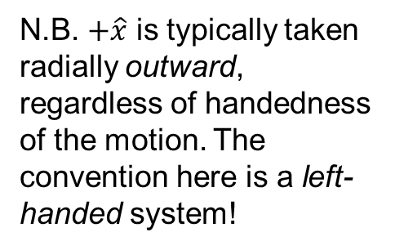
Frenet-Serret Coordinate System
Unless otherwise indicated, coordinates expressed in co-moving frame of ‘reference’ particle
N.B. $+\hat{x}$ is typically taken radially outward, regardless of handedness of the motion. The convention here is a left-handed system!
$$\hat{x}×\hat{y}=−\hat{s} \\ \hat{y}×\hat{s}=−\hat{x} \\ \hat{s}×\hat{x}=−\hat{y}$$

Slide 10
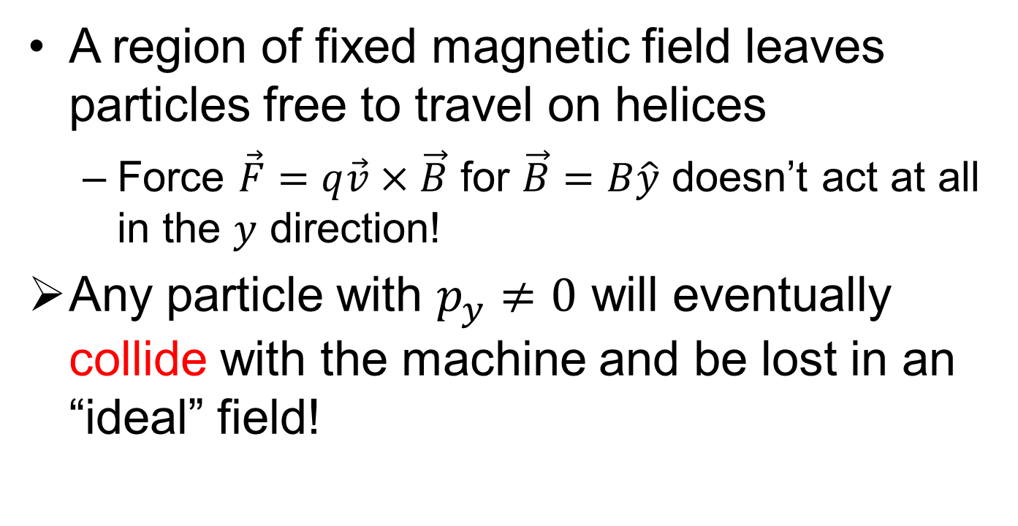
Weak focusing
A region of fixed magnetic field leaves particles free to travel on helices
Force $\vec{F}=q\vec{v}×\vec{B}$ for $\vec{B}=B\hat{y}$ doesn’t act at all in the $y$ direction!
Any particle with $p_{y}≠0$ will eventually collide with the machine and be lost in an “ideal” field!

Slide 11
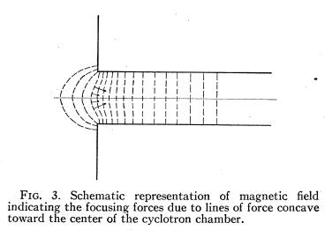
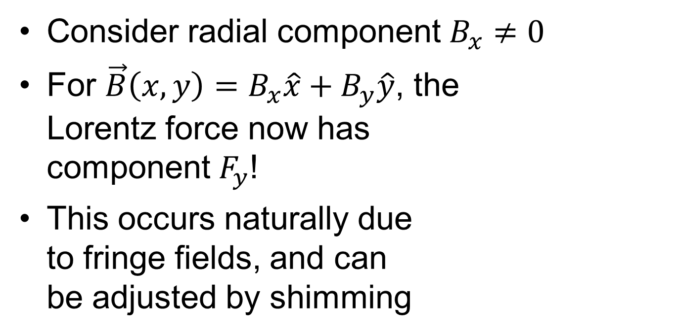
Weak focusing
Consider radial component $B_{x}≠0$
For $\vec{B}\left(x,y\right)=B_{x}\hat{x}+B_{y}\hat{y}$, the Lorentz force now has component $F_{y}$!
This occurs naturally due to fringe fields, and can be adjusted by shimming
Figure from Rose (1938) under fair use

Slide 12
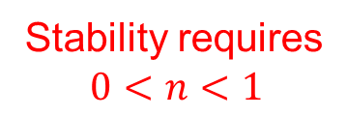
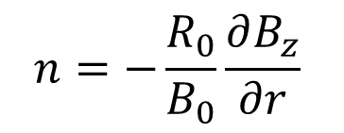
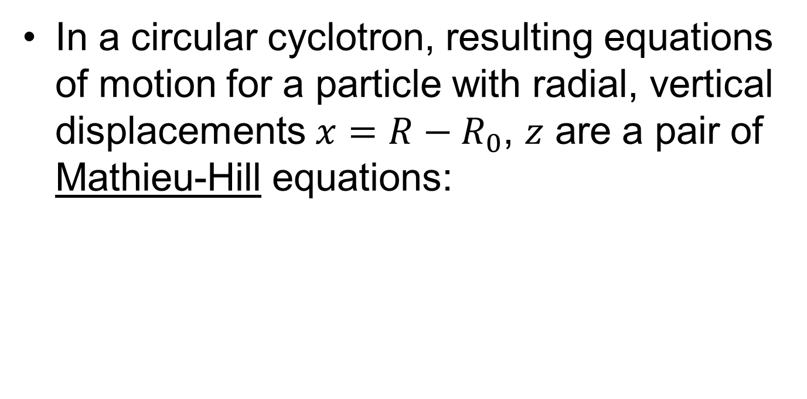
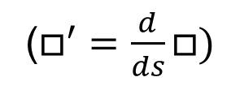
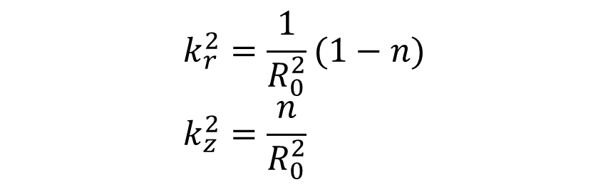
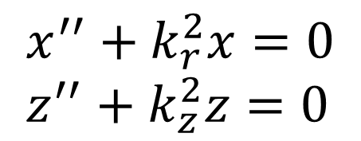
Weak focusing
In a circular cyclotron, resulting equations of motion for a particle with radial, vertical displacements $x=R−R_{0}$, $z$ are a pair of Mathieu-Hill equations:
$$x^{′′}+k_{r}^{2}x=0 \\ z^{′′}+k_{z}^{2}z=0$$
$$k_{r}^{2}=\frac{1}{R_{0}^{2}}(1−n) \\ k_{z}^{2}=\frac{n}{R_{0}^{2}}$$
$$n=−\frac{R_{0}}{B_{0}}\frac{∂B_{z}}{∂r}$$
Stability requires $$0<n<1$$
($□^{′}=\frac{d}{ds}□)$

Slide 13
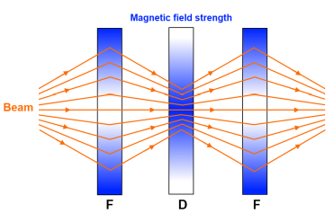
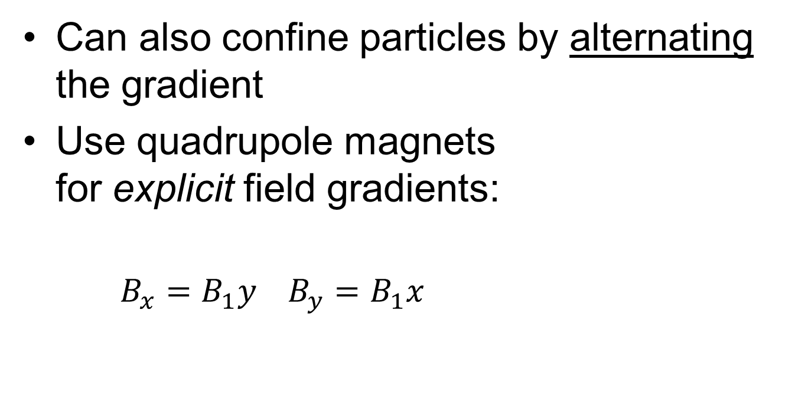
Strong focusing
Can also confine particles by alternating the gradient
Use quadrupole magnets for explicit field gradients:
$B_{x}=B_{1}y B_{y}=B_{1}x$
Figure from the Fermilab “Rookie” book under fair use

Slide 14
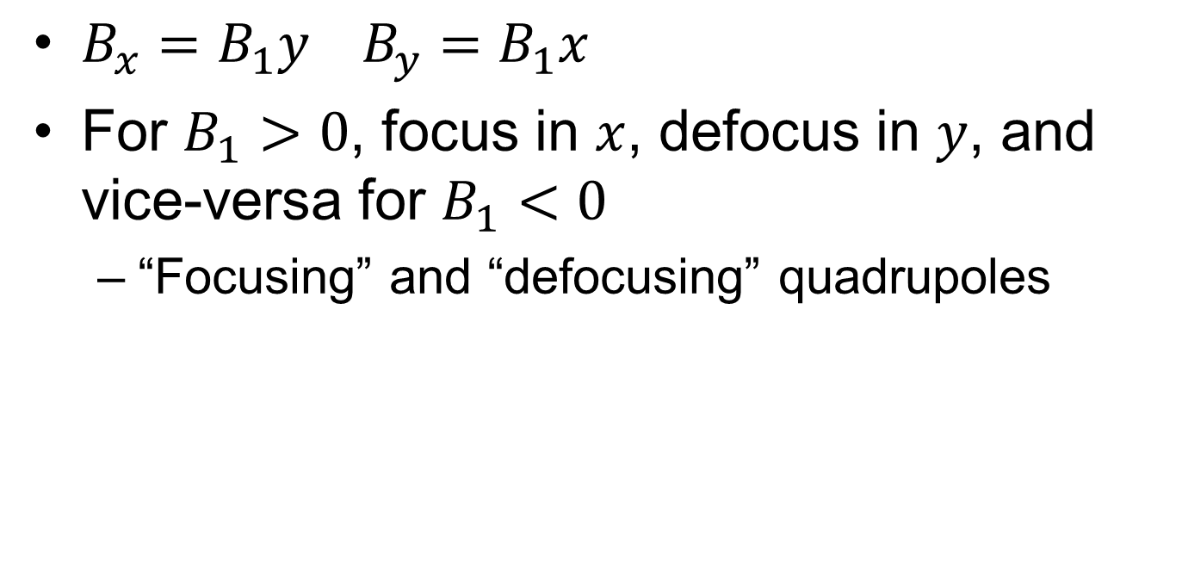
Strong focusing
$B_{x}=B_{1}y B_{y}=B_{1}x$
For $B_{1}>0$, focus in $x$, defocus in $y$, and vice-versa for $B_{1}<0$
“Focusing” and “defocusing” quadrupoles

Slide 15
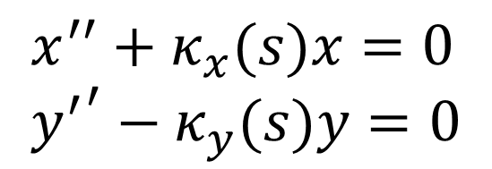
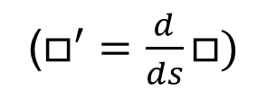
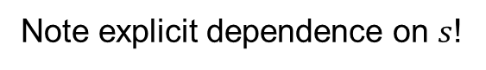
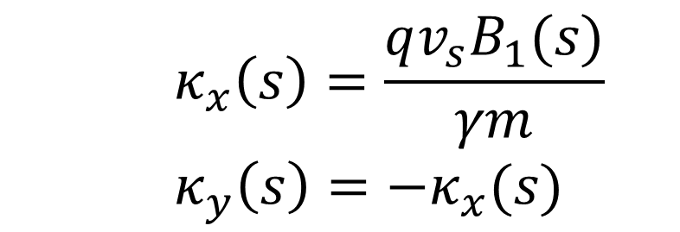
Strong focusing
Analysis shows that particle motion in a quadrupole is also governed by a pair of Mathieu-Hill equations
$$κ_{x}\left(s\right)=\frac{qv_{s}B_{1}(s)}{γm} \\ κ_{y}\left(s\right)=−κ_{x}(s)$$
$$x^{′′}+κ_{x}(s)x=0 \\ {y^{′}}^{′}−κ_{y}(s)y=0$$
($□^{′}=\frac{d}{ds}□)$
Note explicit dependence on $s$!

Slide 16
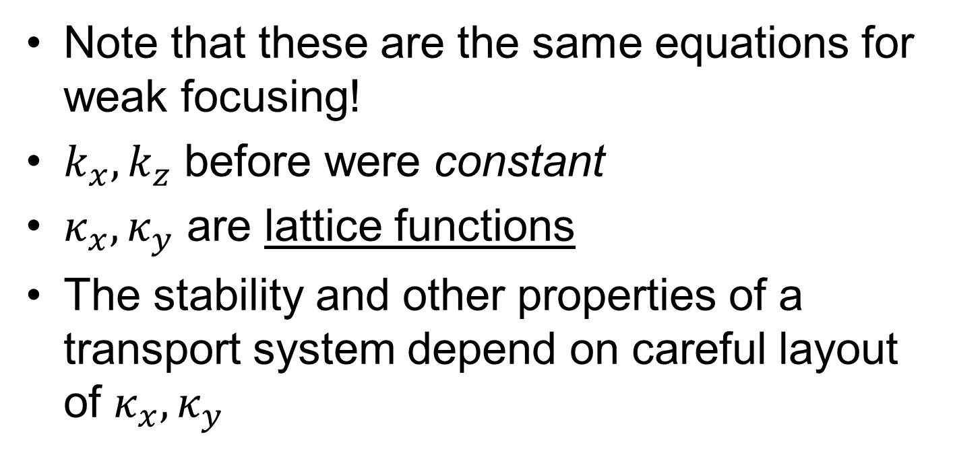
Difference between weak/strong focusing
Note that these are the same equations for weak focusing!
$k_{x},k_{z}$ before were constant
$κ_{x},κ_{y}$ are lattice functions
The stability and other properties of a transport system depend on careful layout of $κ_{x},κ_{y}$

Slide 17
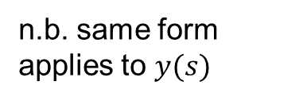
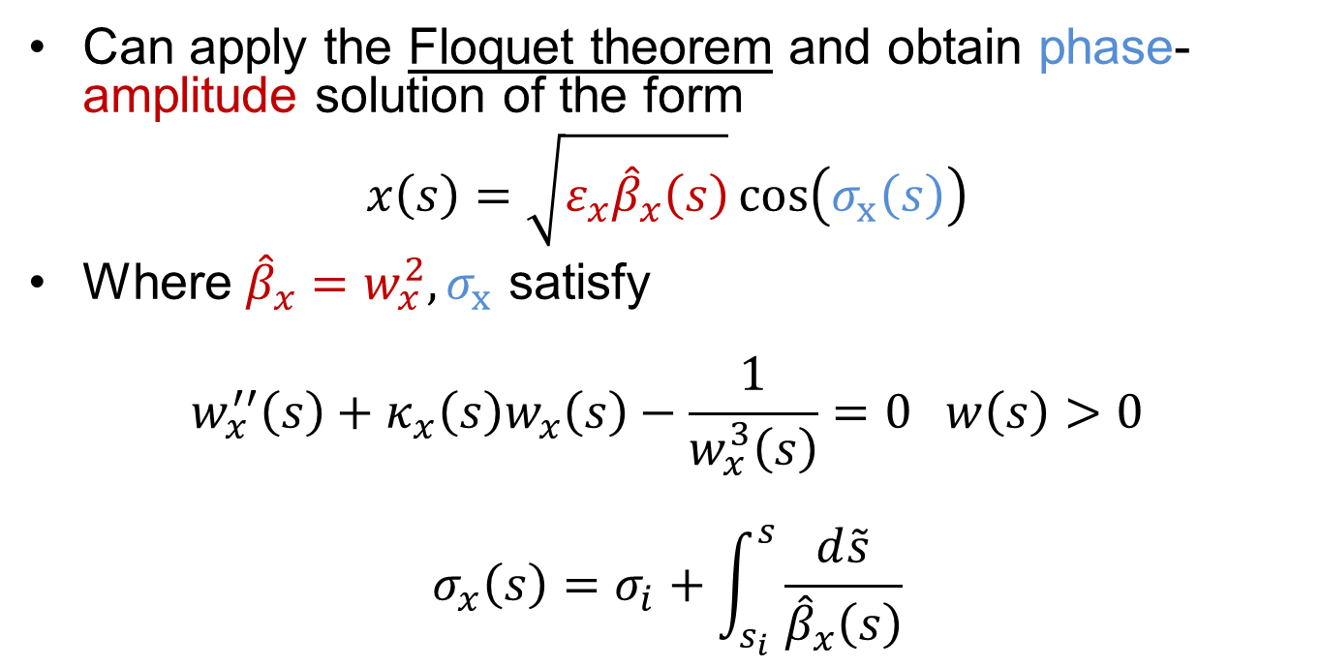
Courant Snyder parameterization
Can apply the Floquet theorem and obtain phase-amplitude solution of the form
$$x\left(s\right)=\sqrt{ε_{x}{\hat{β}}_{x}\left(s\right)}\cos\left(σ_{x}\left(s\right)\right)$$
Where ${\hat{β}}_{x}=w_{x}^{2},σ_{x}$ satisfy
$$w_{x}^{′′}\left(s\right)+κ_{x}\left(s\right)w_{x}\left(s\right)−\frac{1}{w_{x}^{3}\left(s\right)}=0 w\left(s\right)>0 \\ σ_{x}\left(s\right)=σ_{i}+\int_{s_{i}}^{s}{\frac{d\tilde{s}}{{\hat{β}}_{x}\left(s\right)}}$$
n.b. same form applies to $y(s)$

Slide 18
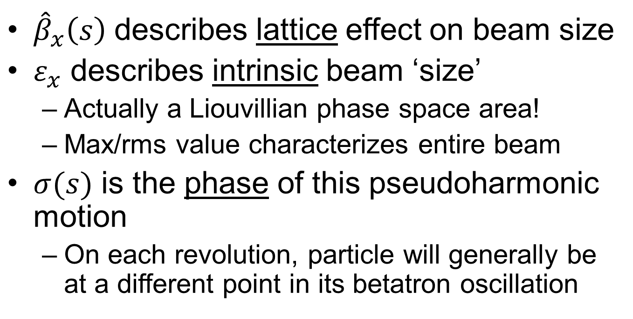
Advantages of Courant-Snyder formalism
${\hat{β}}_{x}\left(s\right)$ describes lattice effect on beam size
$ε_{x}$ describes intrinsic beam ‘size’
Actually a Liouvillian phase space area!
Max/rms value characterizes entire beam
$σ(s)$ is the phase of this pseudoharmonic motion
On each revolution, particle will generally be at a different point in its betatron oscillation

Slide 19
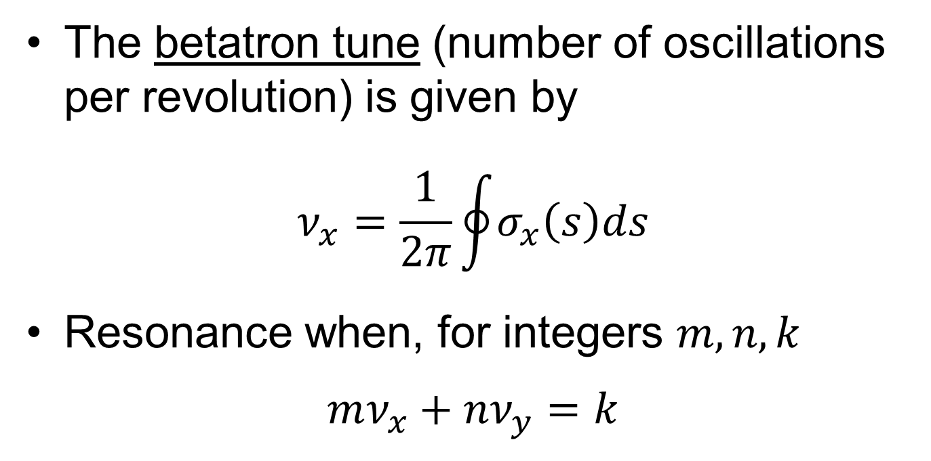
Betatron tune
The betatron tune (number of oscillations per revolution) is given by
$$ν_{x}=\frac{1}{2π}\oint{σ_{x}\left(s\right)ds}$$
Resonance when, for integers $m,n,k$
$$mν_{x}+nν_{y}=k$$

Slide 20
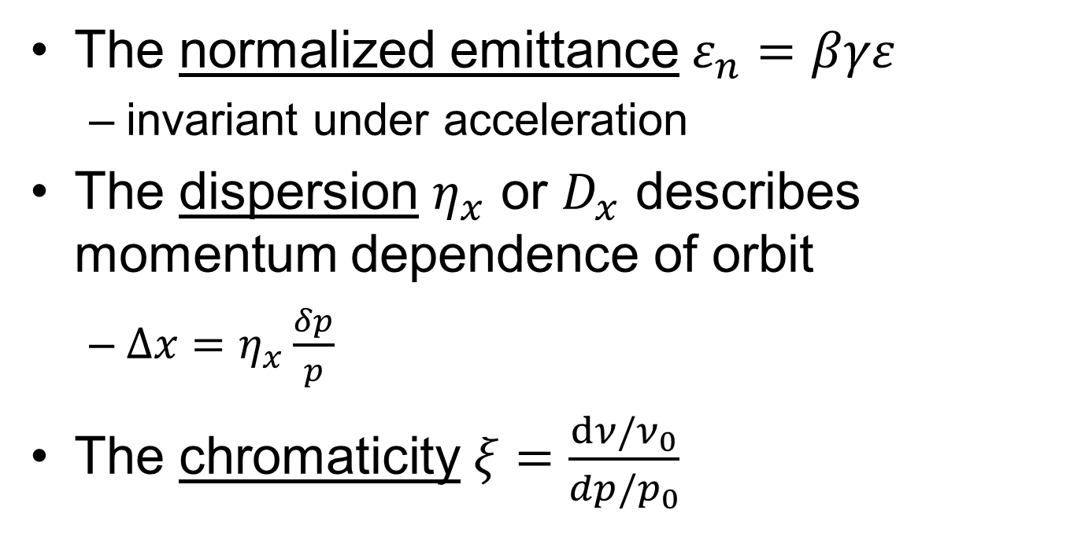
Other parameters of interest
The normalized emittance $ε_{n}=βγε$
invariant under acceleration
The dispersion $η_{x}$ or $D_{x}$ describes momentum dependence of orbit
$Δx=η_{x}\frac{δp}{p}$
The chromaticity $ξ=\frac{dν/ν_{0}}{dp/p_{0}}$

Slide 21
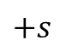
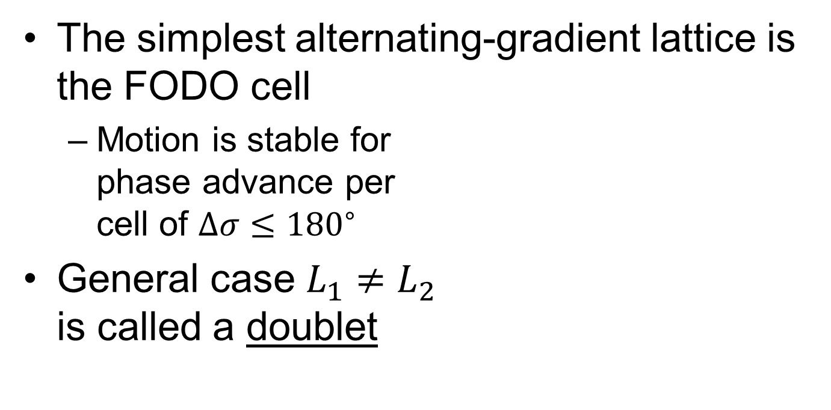
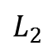
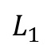
Strong focusing lattices
The simplest alternating-gradient lattice is the FODO cell
Motion is stable for phase advance per cell of $Δσ≤{180}^{∘}$
General case $L_{1}≠L_{2}$ is called a doublet
$$L_{1}$$
$$L_{2}$$
F
F
F
O
D
O
$$+s$$

Slide 22
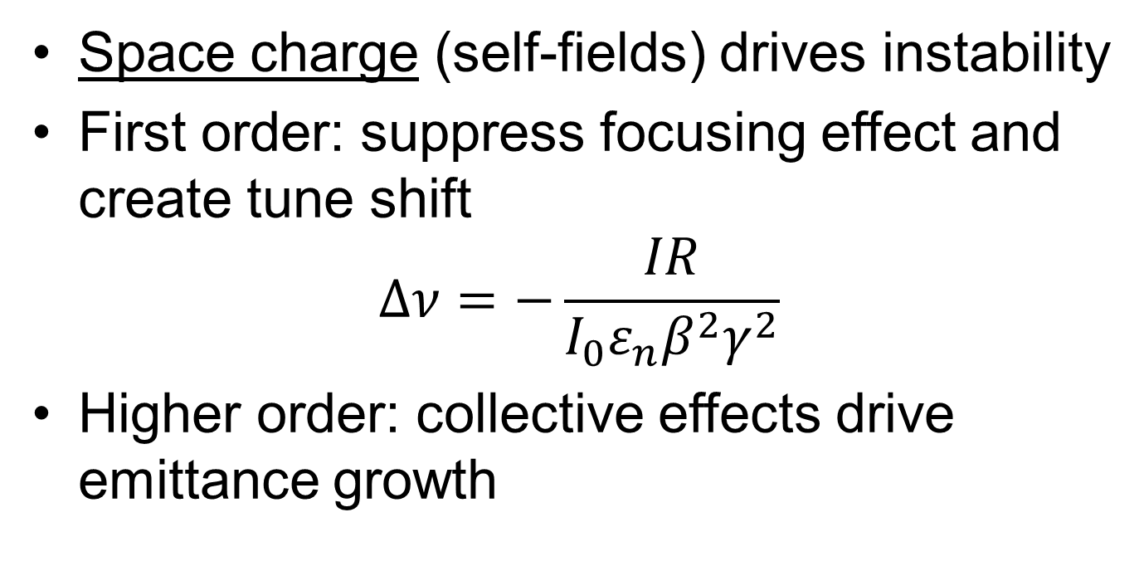
The effect of space charge on stability
Space charge (self-fields) drives instability
First order: suppress focusing effect and create tune shift
$$Δν=−\frac{IR}{I_{0}ε_{n}β^{2}γ^{2}}$$
Higher order: collective effects drive emittance growth

Slide 23
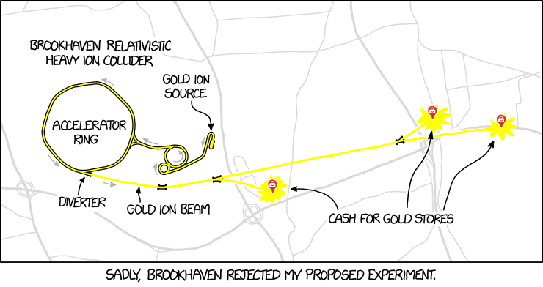
Congrats, you’re a (transverse) accelerator physicist!
Image from https://xkcd.com/2007/ under CC BY-NC 2.5

Slide 24
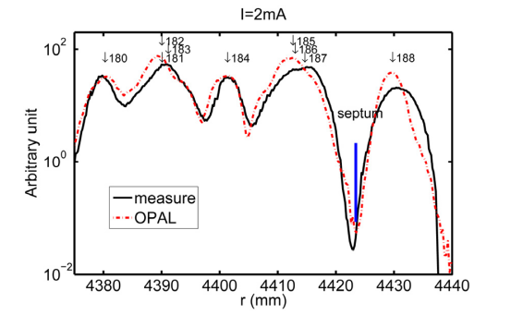
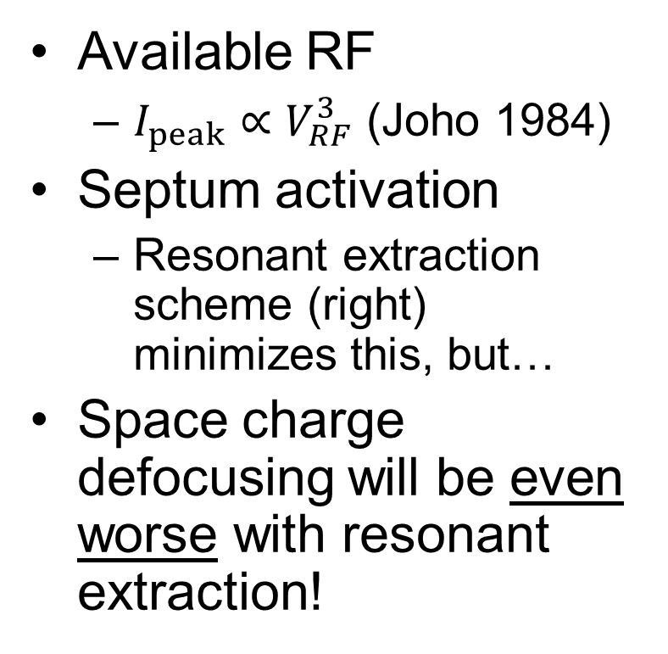
What limits the current at PSI?
Available RF
$I_{peak}∝V_{RF}^{3}$ (Joho 1984)
Septum activation
Resonant extraction scheme (right) minimizes this, but…
Space charge defocusing will be even worse with resonant extraction!
Figure from Seidel et al. (2010) used here under fair use.

Slide 25
How to build a high-intensity machine? Or: “Dear Santa…”
Fully separated turns
The most critical upgrade path at PSI has been turning up the RF power!
Close control over betatron motion
More knobs = more flexibility in tuning
Compensate space charge with as much focusing as possible

Slide 26
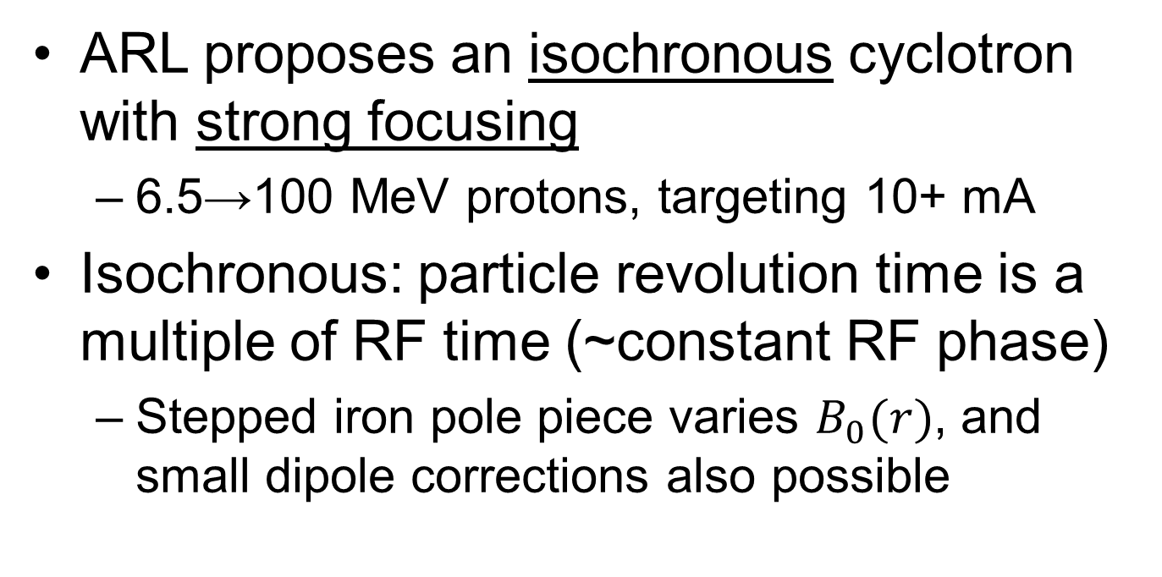
SFC design
ARL proposes an isochronous cyclotron with strong focusing
6.5→100 MeV protons, targeting 10+ mA
Isochronous: particle revolution time is a multiple of RF time (~constant RF phase)
Stepped iron pole piece varies $B_{0}(r)$, and small dipole corrections also possible

Slide 27
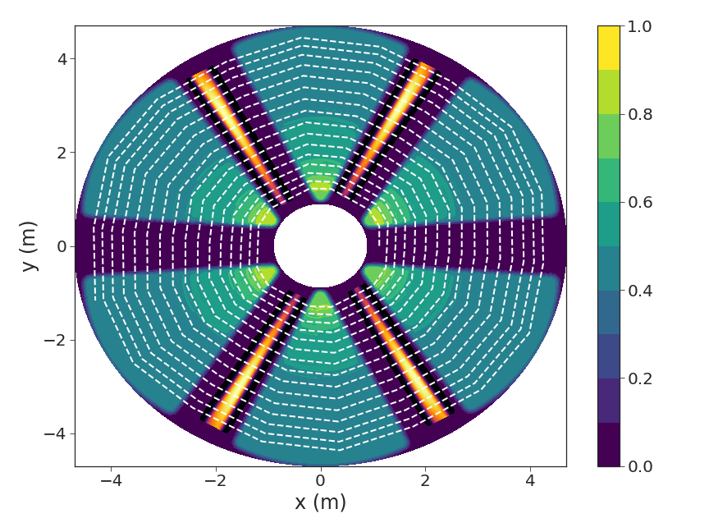
SFC design
Six sectors, four accelerating cavities
A beam transport channel is located in each arc for local focusing

Slide 28
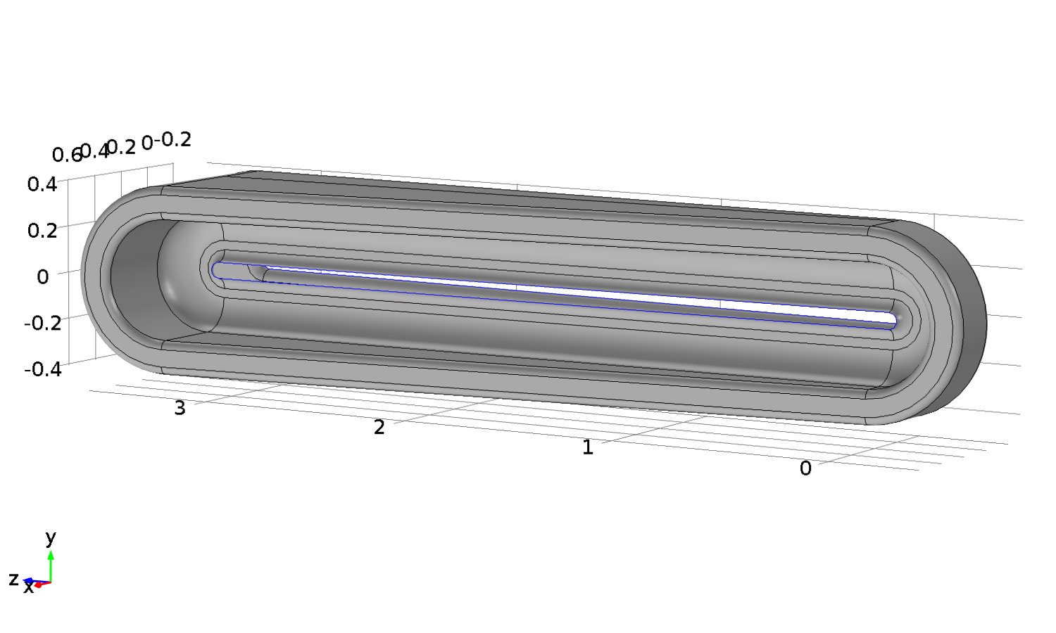
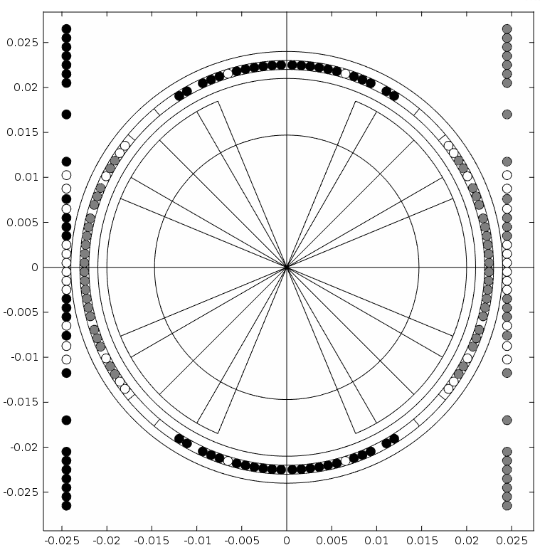
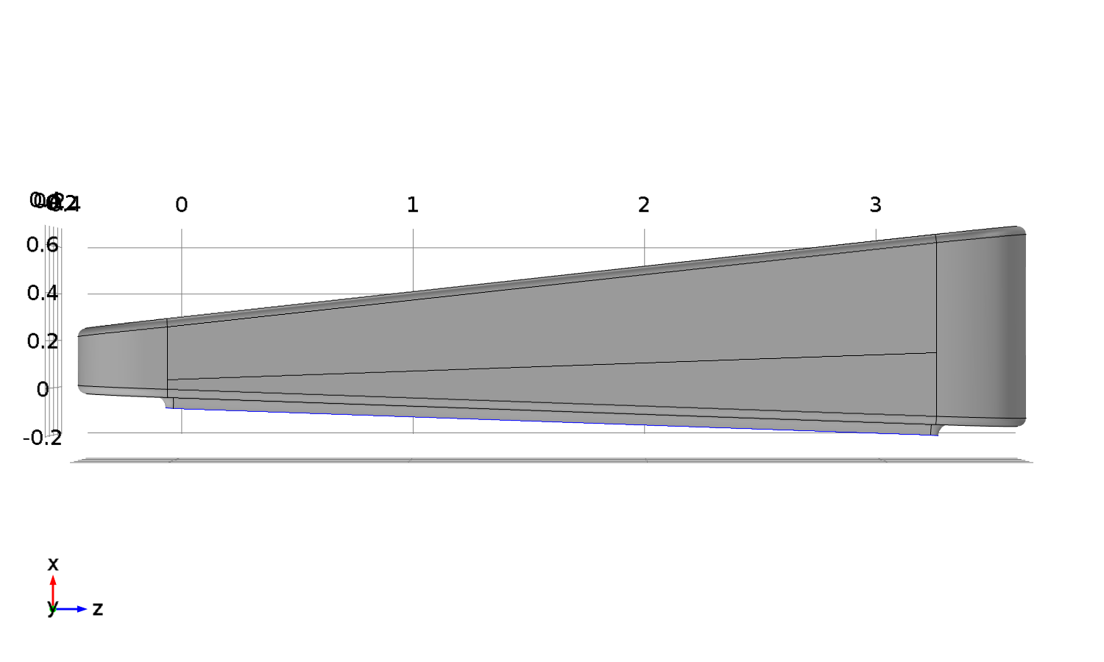
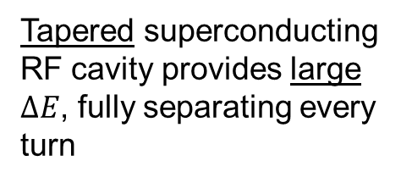
The hardware of the SFC
A beam transport channel with dipole and Panofsky quadrupole windings and good aperture
Tapered superconducting RF cavity provides large $ΔE$, fully separating every turn

Slide 29
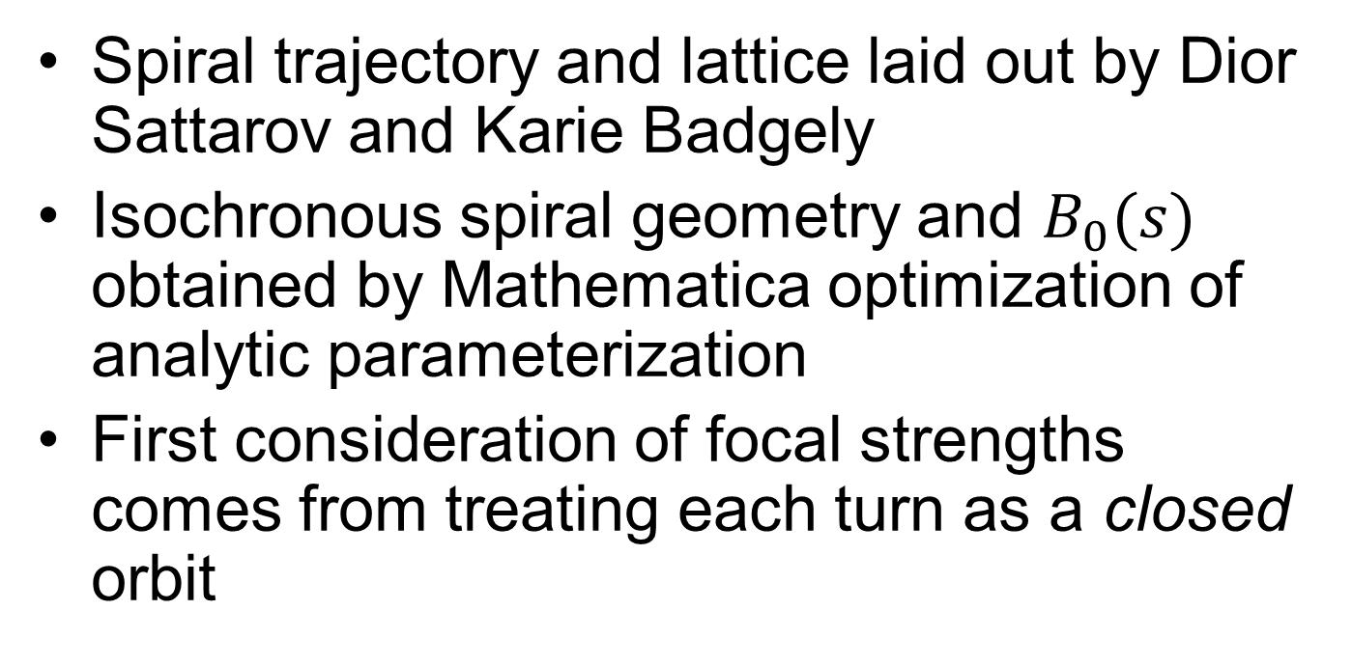
Design of the SFC
Spiral trajectory and lattice laid out by Dior Sattarov and Karie Badgely
Isochronous spiral geometry and $B_{0}(s)$ obtained by Mathematica optimization of analytic parameterization
First consideration of focal strengths comes from treating each turn as a closed orbit

Slide 30
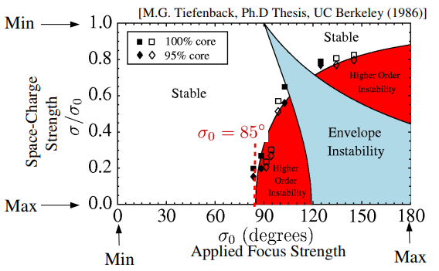
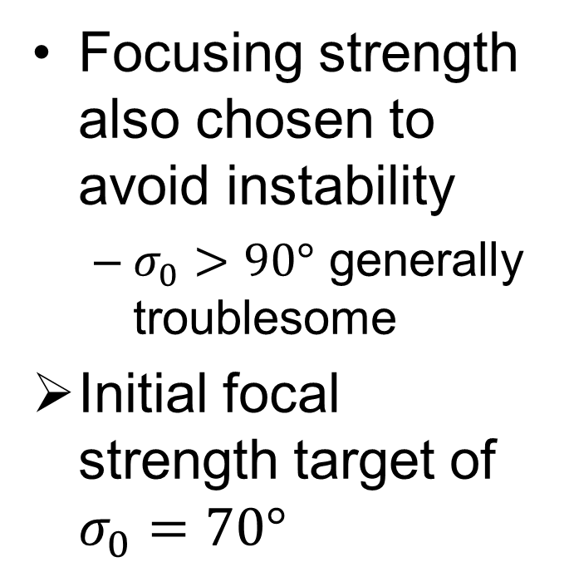
Design of the SFC
Focusing strength also chosen to avoid instability
$σ_{0}>90°$ generally troublesome
Initial focal strength target of $σ_{0}=70°$
Figure from the (excellent!) notes of Steve Lund used here under fair use.

Slide 31
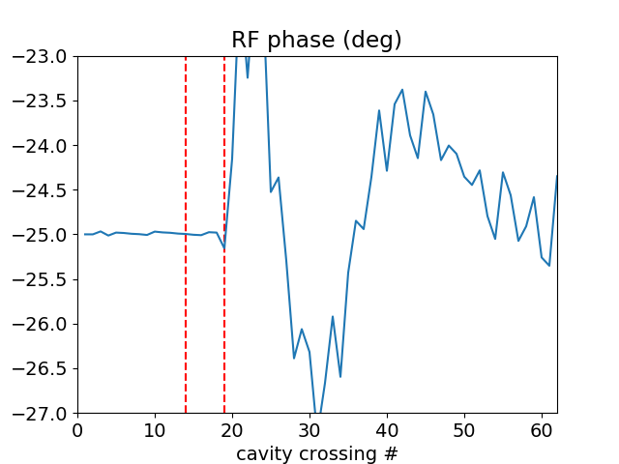
Design of the SFC
Dipole corrector settings can be chosen to optimize isochronicity…
…but put plainly, this isn’t working right (yet!)

Slide 32
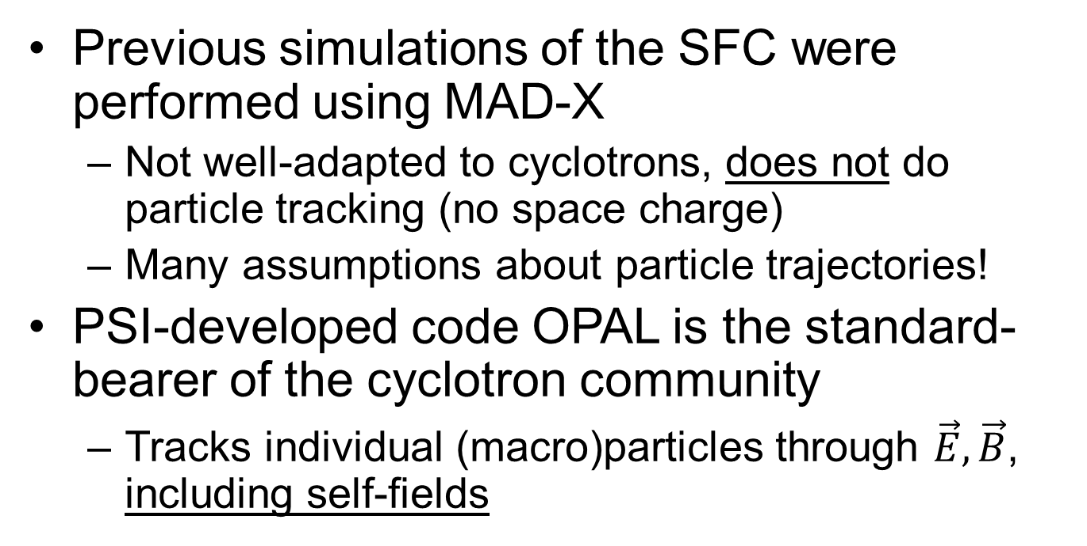
Simulation in OPAL
Previous simulations of the SFC were performed using MAD-X
Not well-adapted to cyclotrons, does not do particle tracking (no space charge)
Many assumptions about particle trajectories!
PSI-developed code OPAL is the standard-bearer of the cyclotron community
Tracks individual (macro)particles through $\vec{E}, \vec{B}$, including self-fields

Slide 33

Simulation in OPAL
Our OPAL simulations use fieldmaps output directly from software Opera (magnetic fields) and COMSOL (cavity fields)
No assumptions about field profiles/etc. necessary
Caveat: more computationally expensive, extracting parameters like $\hat{β}$, $η$ becomes more complex

Slide 34

Simulation results: no space charge
100% transport of Gaussian beam with realistic spot-size (3 mm)
Ellipses rotate as expected
Linear transport is properly resolved

Slide 35

Simulation results: with space charge
Have been able to transport ~85% of 5 mA beam
Space charge effects well-resolved
Beam halo and “S” shape

Slide 36


Simulation results: losses
Beam appears stable until $t≈2.5 μs$, where a steady loss emerges

Slide 37

Simulation results: losses
This loss appears to be associated with a longitudinal separation in the beam
Possible that a fieldmap tuned for more strict isochronicity will not have this loss mode

Slide 38

Simulation results: envelope & emittance

Slide 39
Simulation results: envelope & emittance
Divergence of max from 3σ value and formation of beam larger halo associated with large radial/longitudinal excursions

Slide 40


Betatron tune from Fourier analysis
Target phase advance of $σ_{0}=70°$ corresponds to $ν=1.17$ (not including $ρ^{−2}$ focusing)

Slide 41
Simulation of other beam distributions
Computational stability depends strongly on initial distribution
Often “written in stone” by the injector
With intense space charge, beam is unlikely to be Gaussian
Screen effect → more uniform interior

Slide 42




Simulation of other beam distributions
Waterbag $$f\left(H_{⊥}\right)=θ(H_{⊥}−H_{0})$$
KV $$f\left(H_{⊥}\right)=δ(H_{⊥}−H_{0})$$

Slide 43

Future work
Characterize evolution of different profiles
Essential to understand the matched profile to constrain the injector requirements
More fully characterize machine optics
In particular, effect of space charge on $\hat{β}, D$
Potential for dispersion compensation
Optimization of isochronicity and quadrupole settings

Slide 44

Acknowledgements
TAMU ARL team
Dior Sattarov, for patient guidance
Saeed Assadi, for providing hardware

Slide 45

Thank you!

Slide 46
Backup Slides

Slide 47


Longitudinal stability
For operation below transition ($γ<γ_{t}$)

Slide 48


Radiation limitation at PSI
Figure from Stammbach et al. (2001) used here under fair use.
Figure from Seidel et al. (2010) used here under fair use.

Slide 49


Simulation results: Twiss parameters
Can extract $\hat{β}$ values by assuming Courant-Snyder solution, but this is fragile

Slide 50


KV beam losses

Slide 51

Strong focusing
From the relativistic Lorentz force law…
$$x^{′′}+\frac{qv_{s}B_{y}}{γm}=0 \\ {y^{′}}^{′}−\frac{qv_{s}B_{x}}{γm}=0$$

Slide 52

Strong focusing
For strictly quadrupole fields, we have
$$x^{′′}+\frac{qv_{s}B_{1}}{γm}x=0 \\ {y^{′}}^{′}−\frac{qv_{s}B_{1}}{γm}y=0$$

Slide 53

Strong focusing
Full motion (including dipoles) of proton without acceleration or electric fields can be expressed in terms of the Hamiltonian $\tilde{H}=−p$. For $p_{x},p_{y}≪p$, we have
$$\tilde{H}≈−p\left(1+\frac{x}{ρ}\right)+\frac{1+x/ρ}{2p}\left[{\left(p_{x}−eA_{x}\right)}^{2}+{\left(p_{y}−eA_{y}\right)}^{2}\right]−eA_{s}$$

Slide 54

Strong focusing
Assuming only transverse magnetic field ($A_{x}=A_{y}=0$), applying Hamilton’s equations, we obtain
$$x^{′′}−\frac{ρ+x}{ρ^{2}}=\frac{B_{y}}{B_{0}ρ}\frac{p_{0}}{p}{\left(1+\frac{x}{ρ}\right)}^{2}$$
$$y^{′′}=\frac{B_{x}}{B_{0}ρ}\frac{p_{0}}{p}{\left(1+\frac{x}{ρ}\right)}^{2}$$

Slide 55

Strong focusing
Assuming $p_{0}=p$, and expanding up to first order in $x,y$, we can express these as a pair of Mathieu-Hill equations
$$x^{′′}+κ_{x}x=0 \\ y^{′′}+κ_{y}y=0 \\ κ_{x}=\frac{1}{ρ^{2}}−\frac{B_{1}}{B_{0}ρ} \\ κ_{y}=\frac{B_{1}}{B_{0}ρ}$$

Slide 56



Courant Snyder parameterization
Twiss parameters describe the effect of the lattice on the beam
The emittance $ε_{x}$ obeys the relationship
$${\hat{γ}}_{x}x^{2}+2{\hat{α}}_{x}xx^{′}+{\hat{β}}_{x}x^{′2}=ε_{x}$$
$${\hat{β}}_{x}^{2}(s)=w_{x} \\ {\hat{α}}_{x}\left(s\right)=−w_{x}w_{x}′$$
$${\hat{γ}}_{x}\left(s\right)=\frac{1}{w^{2}}+{w^{′}}^{2}$$

